Slide 1







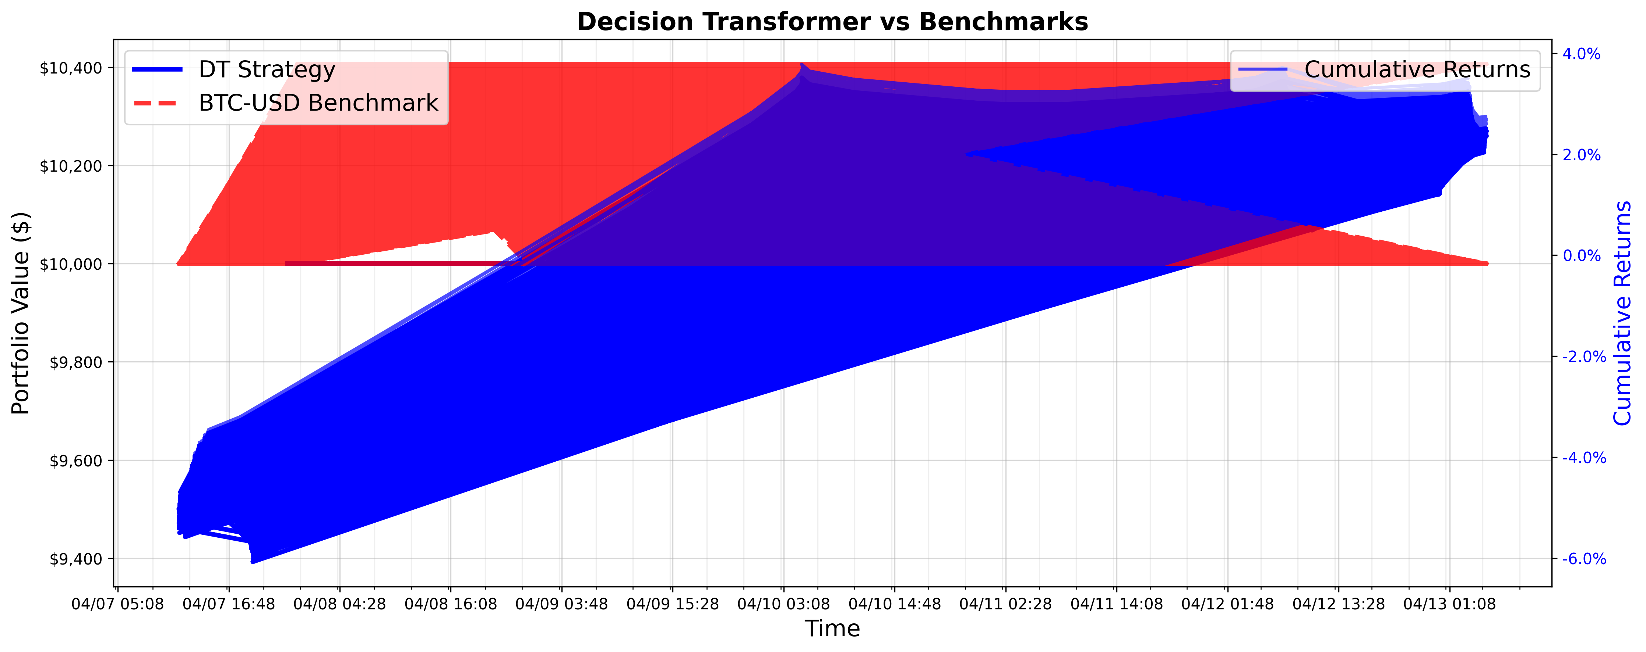
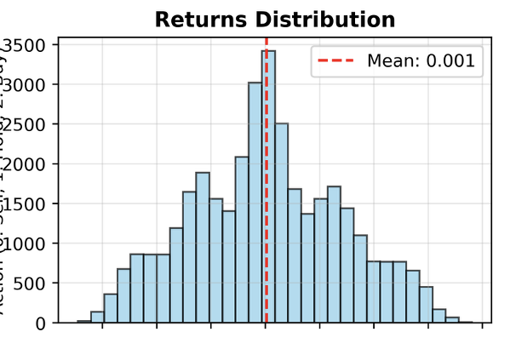
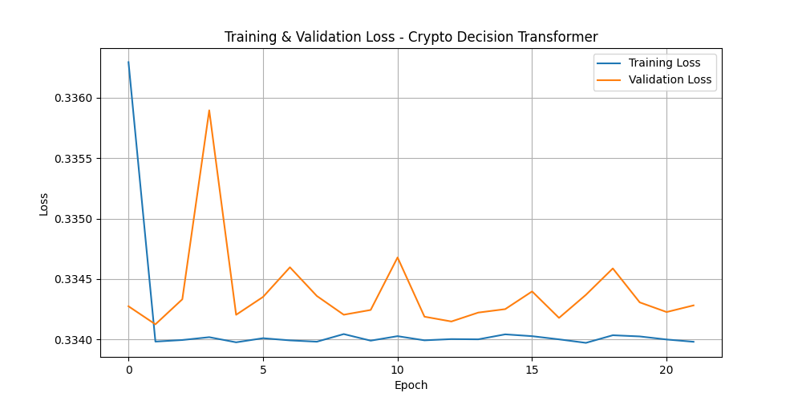


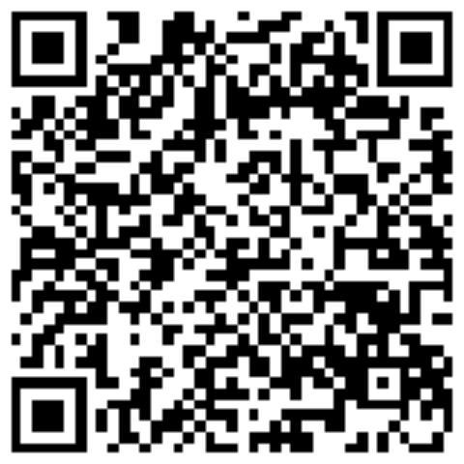
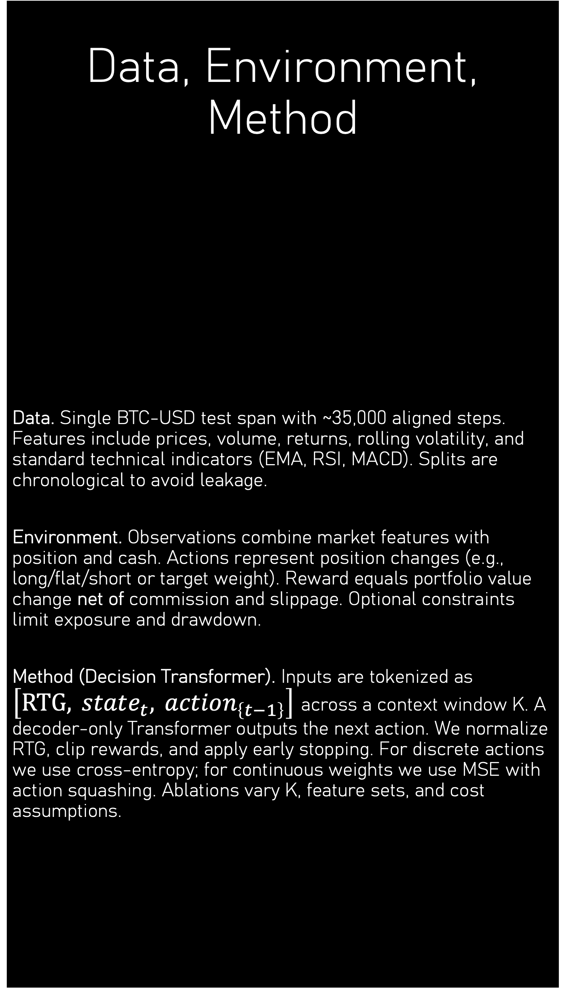
Decision Transformer for Crypto Trading in FinRL Trajectories → Training → Backtest with Costs BTC-USD backtest (~35k steps): Sharpe 0.27 vs. 0.11 benchmark; Return −4.6% (MDD −9.5%, Vol 55%) Authors: Alexei Savin
Goal & Pipeline
Goal. Evaluate a Decision Transformer (DT) for BTC-USD trading within the FinRL pipeline under realistic costs. DT treats reinforcement learning as sequence modeling: conditioned on return-to-go (RTG), past states, and past actions, it predicts the next action. This enables offline training and mitigates instability from non-stationary markets.
Pipeline.
Data: load OHLCV for selected pairs and engineer indicators.
Environment: FinRL gym-style crypto market with transaction costs and optional risk constraints.
Trajectories: create (state, action, reward) sequences from historical strategies or baseline RL.
Train DT on trajectories with RTG conditioning.
Validation & backtest with commission and slippage.
Reporting: equity curve, risk metrics, and ablations.
Data, Environment, Method
Data. Single BTC-USD test span with ~35,000 aligned steps. Features include prices, volume, returns, rolling volatility, and standard technical indicators (EMA, RSI, MACD). Splits are chronological to avoid leakage.
Environment. Observations combine market features with position and cash. Actions represent position changes (e.g., long/flat/short or target weight). Reward equals portfolio value change net of commission and slippage. Optional constraints limit exposure and drawdown.
Method (Decision Transformer). Inputs are tokenized as $\left[RTG, state_{t}, action_{\left\{t−1\right\}}\right]$ across a context window K. A decoder-only Transformer outputs the next action. We normalize RTG, clip rewards, and apply early stopping. For discrete actions we use cross-entropy; for continuous weights we use MSE with action squashing. Ablations vary K, feature sets, and cost assumptions.
Results, Insights, Next Steps
Results (test, net of costs). DT achieves Sharpe 0.27 vs 0.11 for BTC-USD Buy-and-Hold, with Total Return −4.6%, Max Drawdown −9.5%, and Annual Volatility 55%. Benchmark achieves Return 4.1%, MaxDD −3.9%, Vol 22%. Risk-adjusted gain improves (Sharpe), while return lags in this short evaluation.
Trading Statistics. Total actions: 35,000; Buys 7,137 (20.4%); Sells 0; Holds 27,863 (79.6%); Total trades 7,137.
Prediction vs Execution. Predictions: Buy 34,999 (100%), Hold 0, Sell 0. Executed: Buy 7,137, Hold 27,863, Sell 0. Mismatch: 79.6% of steps (prediction ≠ execution).
Next Steps. Refine action discretization and execution rules; add PPO baseline and equity curves; run context-length K ablation; enrich features (order-book/on-chain); explore cost-aware augmentation and DT+actor-critic ensembles.
Fig. 1. Equity curve (net of costs): DT vs. BTC-USD benchmark on the test span.
Model | Total Return | Annualized | Sharpe | Max Drawdown | Annual Volatility | Calmar | Win-rate | Final Value
DT (ours) | −4.61% | −0.03% | 0.274 | −9.50% | 55.08% | −0.003 | 49.96% | $9,539.49
BTC-USD (BH) | 4.06% | 0.03% | 0.112 | −3.90% | 22.16% | 0.007 | 6.15% | $10,405.90
Table 1. Performance metrics after costs (Return, Sharpe, MaxDD, Volatility).
Sharpe: 0.27 (DT) vs. 0.11 (BH)
MaxDD: −9.5% (DT) vs. −3.9% (BH)
Volatility: 55% (DT) vs. 22% (BH)
Return: −4.6% (DT) vs. +4.1% (BH)
Fig. 3 Distribution of step returns on the test set.
About/Contacts
Fig. 2 Training and validation loss.
GitHub
Telegram
LinkedIn

Slide 2


FinGPT-Powered Compliance Agents for SecureFinAI 2025 Multi-task evaluation of a LoRA-augmented financial LLM on Financial Q&A, Sentiment, and XBRL extraction Task_2_FinGPT_Powered_Compliance_Agents Authors: Alexei Savin
Objective & Problem
Objective.
Design and evaluate an LLM-based compliance agent that can (1) answer finance/compliance questions, (2) classify the sentiment of financial text, and (3) extract structured fields from XBRL-like reports. The agent should run with a lightweight PEFT / LoRA adapter and produce auditable, source-grounded outputs.
Motivation.
Compliance and financial supervision tasks are document-heavy and multi-format: short Q&A on rules, long disclosures with sentiment, and structured filings (XBRL). A single agent that can route the user request to the right subtask and return a scored result is more useful than separate scripts.
Agent capabilities.
Financial Q&A - answer domain-specific questions from an evaluation set.
Sentiment analysis - classify financial phrases and news into positive / neutral / negative
XBRL extraction - read structured samples and recover tags, values, and formulae.
Runtime setup.
The repository is evaluated via `make evaluate`. All metrics are saved to `results/evaluation_results.json` for reproducibility.
Architecture & Workflow
Model & configuration.
Mode: peft
Adapter ID: xsa-dev/fingpt-compliance-agents
PEFT base model: meta-llama/Llama-3.2-1B-Instruct
Baseline model: meta-llama/Llama-3.2-1B-Instruct
Baseline Device: mps
PEFT Device: Cuda 1x RTX 4090
Workflow.
1. Load the FinGPT-style financial LLM and attach the LoRA adapter.
2. Select task based on the evaluation pipeline: Financial Q&A → Sentiment → XBRL.
3. Run task-specific evaluator (accuracy, F1, precision/recall, or XBRL field-level metrics).
4. Aggregate results - into an overall score.
Why multi-task?
Compliance scenarios rarely consist of only one kind of question. A realistic system must:
read a rule and answer a question about it (Q&A),
detect tone/polarity of an event or disclosure (sentiment),
and pull exact numbers/tags from filings (XBRL).
Evaluating on all three makes the agent closer to a real “compliance assistant.”
Desired output format.
Verdict - Compliant / Partially compliant / Non-compliant (or: Answer found / Not found)
Evidence - source file / section / tag used to answer
Reasoning - 3–5 sentences grounded on retrieved content
Baseline Results (this run)
Financial Q&A — Accuracy 0.677 (n=31)
Sentiment (baseline evaluator) — Acc 0.418, F1 0.453, Prec 0.546, Rec 0.418 (n=826)
XBRL extraction — Overall accuracy 0.920 (Tag 0.915, Value 0.909, Formula-construct 0.982, Formula-calc 0.885) (n=574)
Overall (aggregated) — Accuracy 0.548, F1 0.453, Precision 0.546, Recall 0.418
Task | Metric(s) | Score | n
Financial Q&A | Accuracy | 0.677 | 31
Sentiment (baseline) | Acc / F1 / Prec / Rec | 0.418 / 0.453 / 0.546 / 0.418 | 826
XBRL extraction | Overall XBRL accuracy | 0.920 | 574
Overall | Accuracy / F1 | 0.548 / 0.453 | —
PEFT Sentiment (separate eval on en-fpb)
Config: PEFT (LoRA) on meta-llama/Llama-3.2-1B-Instruct, dataset ChanceFocus/en-fpb (test n=970)
Accuracy: 0.618
Class-wise (PEFT): Neutral 97.4% | Positive 7.9% | Negative 12.9%
Takeaway: domain-specific PEFT lifts sentiment from ~0.42 → ~0.62,
but positives/negatives remain under-detected (class imbalance).
Conclusions & Next Steps
Strongest: XBRL (~0.92). Financial Q&A: acceptable (~0.68). Weakest: sentiment (~0.42 baseline). PEFT improves sentiment to ~0.62 on a finance dataset; focus on class rebalancing and prompts. Add retrieval/grounding for Q&A; map XBRL fields to checklists (field → rule → pass/fail); expose as auditable JSON report.
About/Contacts
Planned work: extension to multi-modal FinGPT agents (Task 3) — prototype only, not reported here.
GitHub
Telegram
LinkedIn
HuggingFace

Slide 3
FinGPT-Powered Agents for Multi-Modal Financial Data (Task 3) LLM agent that can read financial text, tabular market/fundamental data, and visual/PDF content to produce one grounded answer Task_3_FinGPT_Powered_Agents_MultiModal_Financial_Data Authors: Alexei Savin
Eval dimension | Description | Target / Notes
Multi-modal QA accuracy | Correct answer when data is split across sources
Grounding rate | Answer cites text/table/PDF
Table extraction accuracy | Correct numeric cell from CSV/XBRL
PDF/image extraction | Correct text/number from visual source
Evaluation & Next Steps
Evaluation goals.
Multi-modal QA accuracy — % of questions answered correctly when the answer spans ≥2 modalities.
Grounding rate — % of answers that cite at least one real source (doc, table cell, or PDF page).
Tabular extraction accuracy — when the question requires a number from CSV/XBRL, was the correct cell returned?
Vision/PDF extraction accuracy — when the answer is only on the image/PDF, was OCR/vision good enough?
Latency — total time for “retrieve all + answer”.
Example evaluation tasks (you can list them in the poster even if metrics are still WIP):
Task MM-1 (text → table): “What was the closing price of BTC on the date mentioned in the report?”
Task MM-2 (PDF → text): “Read the revenue number from the slide and restate it.”
Task MM-3 (table → explanation): “This CSV shows a 5% drop. Is there a news explanation in today’s feed?”
What we expect (baseline).
Text-only questions → high accuracy (reuses Task 2 pipeline).
Text + table → medium accuracy (agent must resolve keys/tickers/dates).
Text + PDF/image → lowest accuracy without strong OCR → good target for improvement.
Next steps.
Stronger OCR / vision. Plug in a more robust PDF/image reader for financial charts and slides.
Schema normalization. Standardize column names (date, ticker, close, revenue) so the agent does not guess.
Evidence-first prompting. Force the agent to output “answer + evidence list + modality_used”.
Compare uni-modal vs multi-modal runs. Report the gain from adding table/image to plain text.
Integrate with Task 2 eval. Reuse the same result writer (results/*.json) so all three tasks can be tracked together.
Objective & Problem
Objective. Build a FinGPT-based agent that answers financial questions when the needed evidence is spread across multiple modalities — text (news, reports), tabular data (market prices, fundamentals, XBRL-like tables), and visual/PDF content (figures, charts, slides). The agent should return a single answer and explicitly show which sources were used.
Why multi-modal? Real financial work is rarely text-only. Prices live in CSVs, explanations live in reports, and key numbers often live in charts or PDF pages. A useful agent must be able to (1) find the right piece of information in each modality and (2) fuse it into one consistent response.
Target use cases.
Text + table — “Summarize the news and attach today’s price/volume for the mentioned asset.”
Text + PDF/image — “Extract the EPS or revenue from this slide and explain what changed vs. last quarter.”
Table + text validation — “Check that the value in the CSV matches the textual disclosure.”
Analyst Q&A — “Given this chart and the report snippet, is the move explainable?”
Requirements.
Input can contain a user question plus references to files (CSV/JSON/PDF/image).
Output must be grounded (point back to text/table/page).
Must follow the same agent pattern as Task 2, so it can be evaluated in the same framework.
Architecture & Workflow
Modalities handled.
Text RAG — financial reports, news, policy PDFs (after text extraction).
Tabular reader — CSV/Parquet with OHLCV, fundamentals, or XBRL-like rows.
Vision / PDF step — image or PDF page → OCR or vision encoder → text chunks.
Agent workflow.
Query understanding. Detect user intent and required data types (text / table / image).
Retrieval phase.
If text is needed: run RAG over indexed financial docs.
If table is needed: load the referenced CSV/table and locate the row/column by ticker + date + metric.
If image/PDF is present: run OCR/vision to extract numbers and key labels.
Fusion and reasoning. Feed retrieved text, extracted table cells, and OCR’d snippets into the FinGPT agent with an instruction to produce a single answer and cite evidence.
Response generation. Output = {answer, evidence (text/table/page), modalities_used}.
Logging. Save intermediate retrieval results to enable audit.
Model & configuration.
Core LLM: FinGPT / financial instruction model (same stack as Task 2).
Tools:
text_retriever (indexed financial docs),
table_loader (CSV/XBRL),
vision_reader (image/PDF → text),
optional calculator for derived metrics.
Config via .env and per-task YAML (points to data dirs).
Output format kept JSON-like to simplify evaluation.
Design principles.
Modality-first: agent decides which tool to call before generating.
Grounded: no answer without at least one piece of retrieved evidence.
Composable: same agent loop can run text-only tasks (degrades gracefully).
About/Contacts
GitHub
Telegram
LinkedIn

Slide 4
Выафыв

Slide 5
Выафыв

